Slide 1

The Battle of Neighborhoods
Selecting the best location for investing Thai Restaurant in Manhattan

Slide 2
Introduction and Business Problem
The City of New York is famous for its excellent cuisine. It's food culture includes an array of international cuisines influenced by the city's immigrant history
Thai food is quite diverse and mixed with various spices, It's make Thai food so popular in the United States, but only in Major cities. Therefore, the first thing that must be done before investing is to find the best location. It's a good opportunity to start investing in restaurants in a minor cities

Slide 3
Target Audience
To recommend to the stakeholder or investor who was interested to invest Thai restaurant in Manhattan city at New York

Slide 4
Data Acquisition
New York Datasets has a total of 5 boroughs and 306 neighborhoods
1
Foursquare API that will be leveraged to provision venues information for each neighborhood
2

Slide 5
Methodology – Data Pre-processing
Convert New York datasets into tabular form and then select the datasets only Manhattan city and visualize to ensure the data is selected correctly
Use the Foursquare API to get Thai Restaurant in Manhattan city

Slide 6
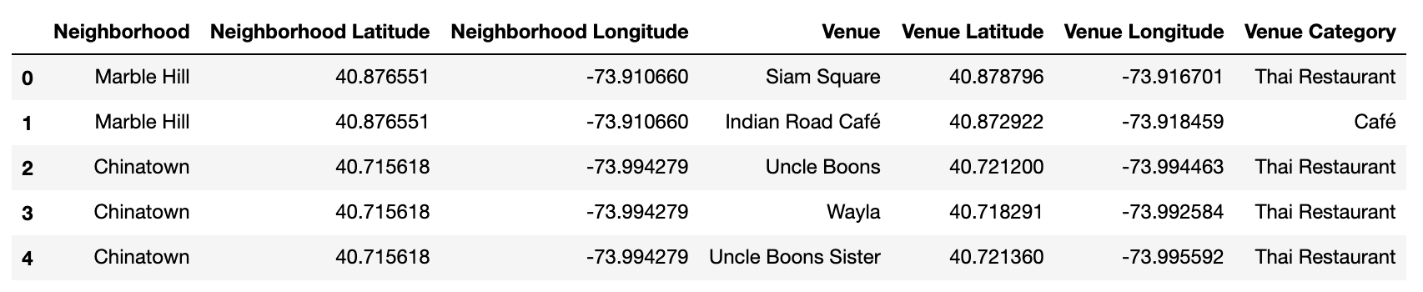

Methodology – Data Pre-processing Cont.

Slide 7
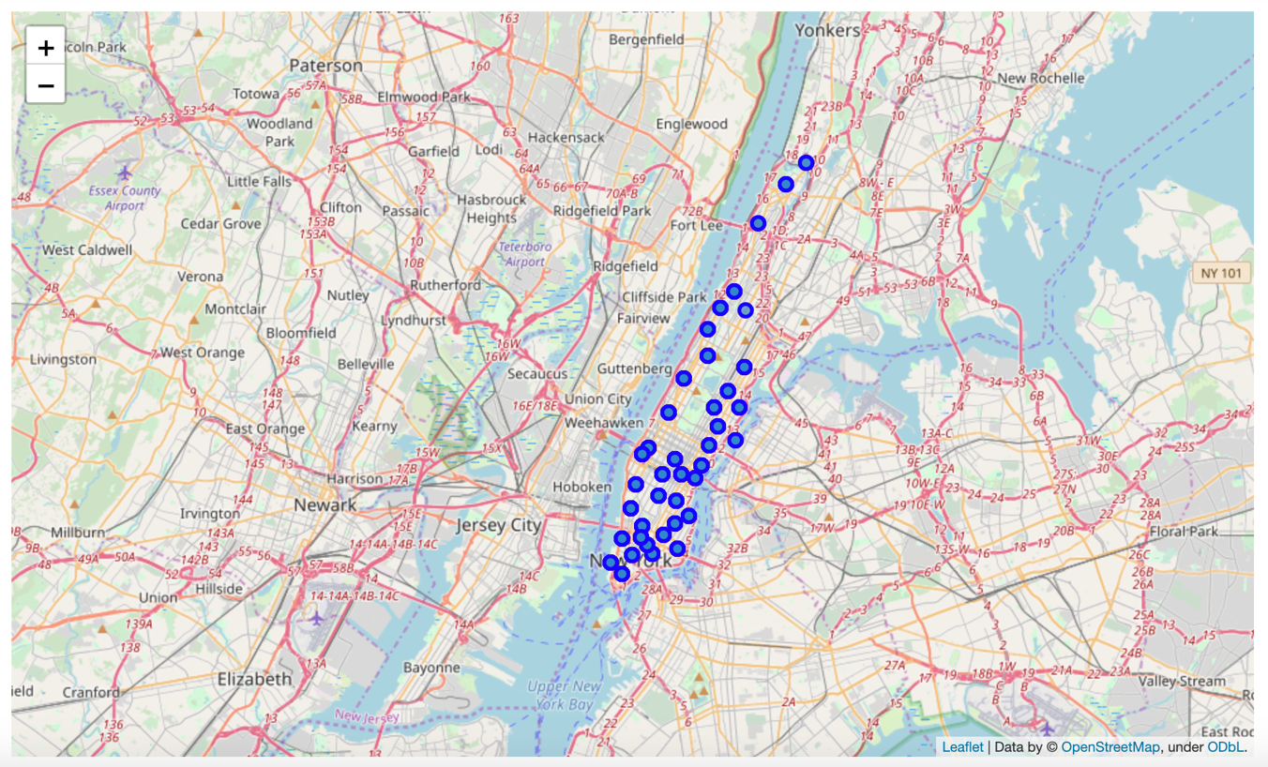
Methodology – Data Pre-processing Cont.
Thai Restaurant in Manhattan

Slide 8
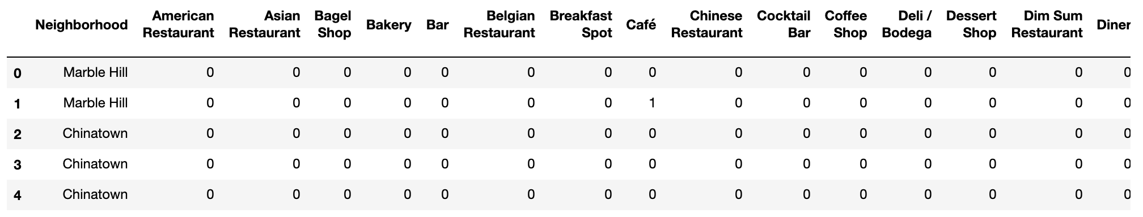
Feature Engineering
Use the one-hot encoding method to encode category data into a binary. then group the output from one-hot encoding to represents ratio Thai restaurant each neighborhood.

Slide 9
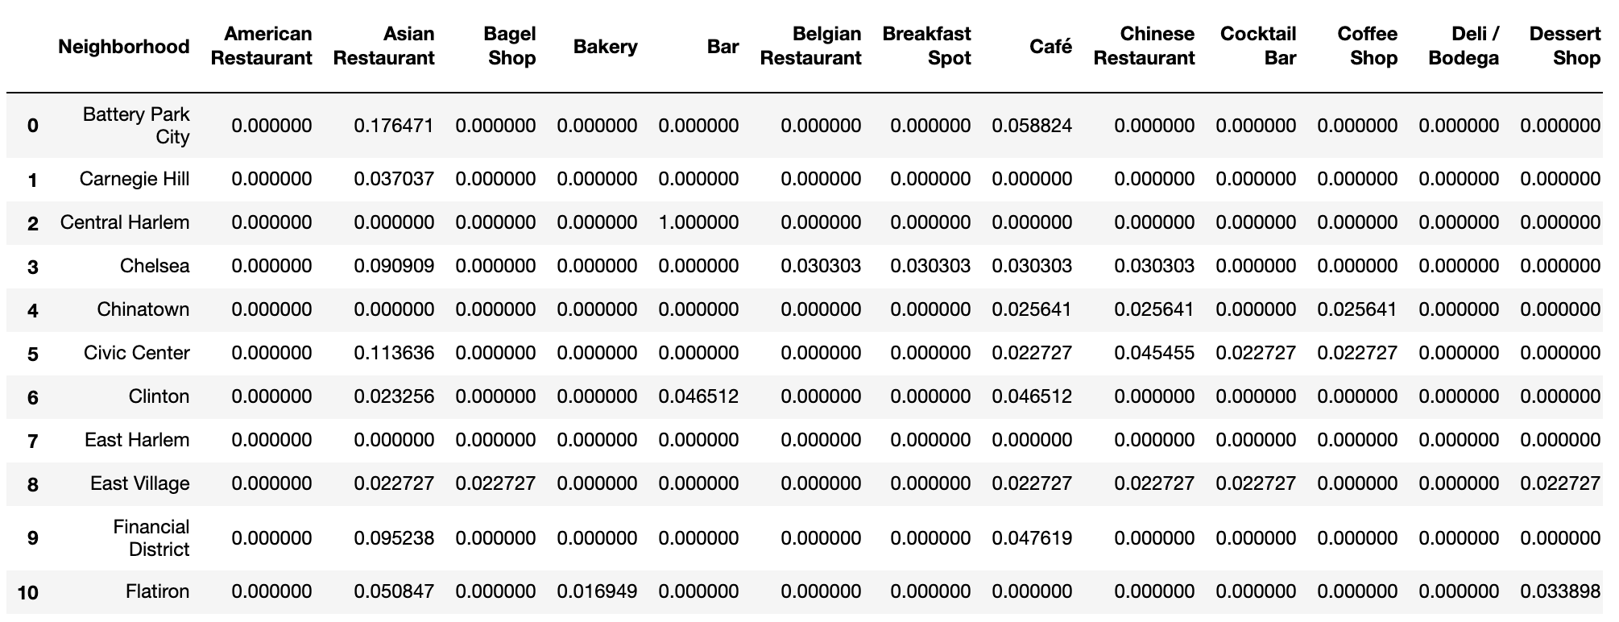
Feature Engineering Cont.
Ratio Thai Restaurant in Manhattan

Slide 10
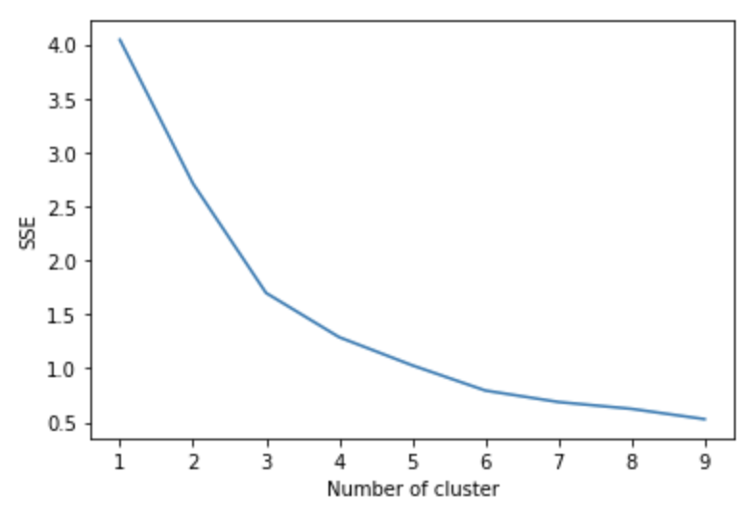
Modeling
Use K-means clustering algorithms to cluster neighborhood at Manhattan. The evaluation of the model using the elbow method so the optimal K is 6 ks

Slide 11
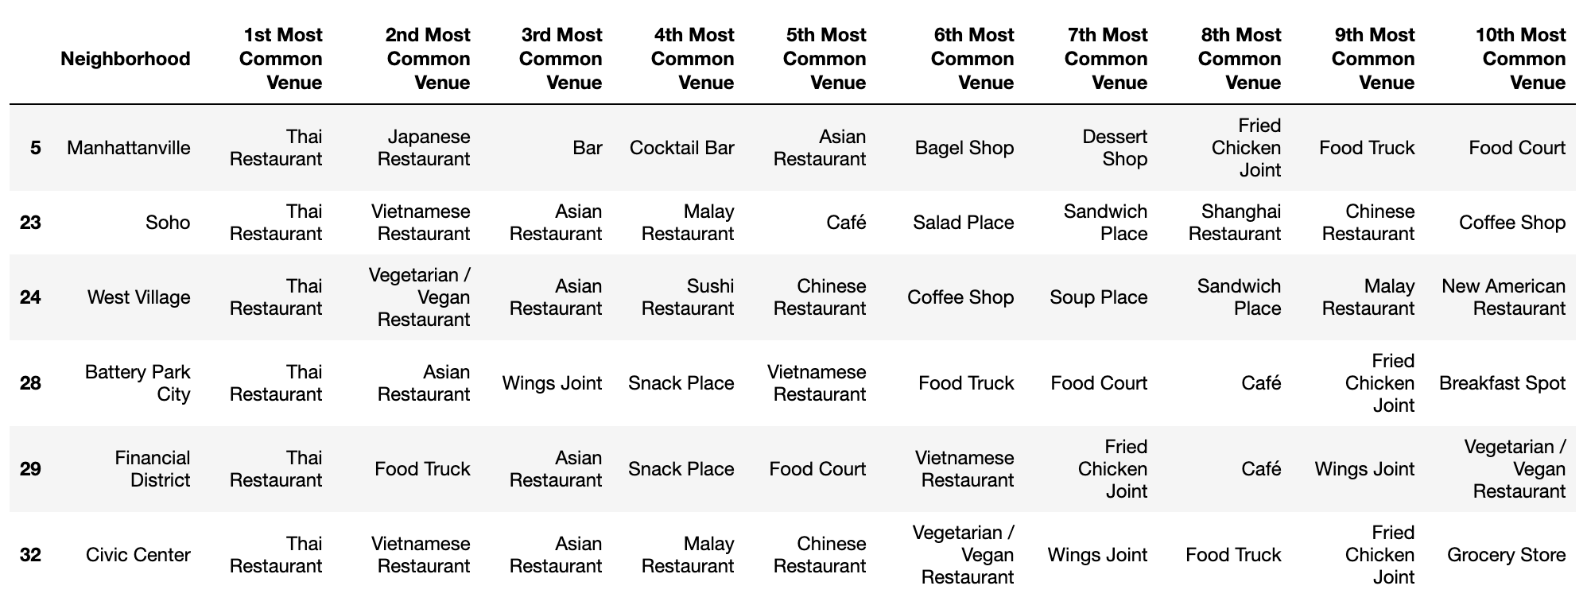
Results – Cluster 0

Slide 12
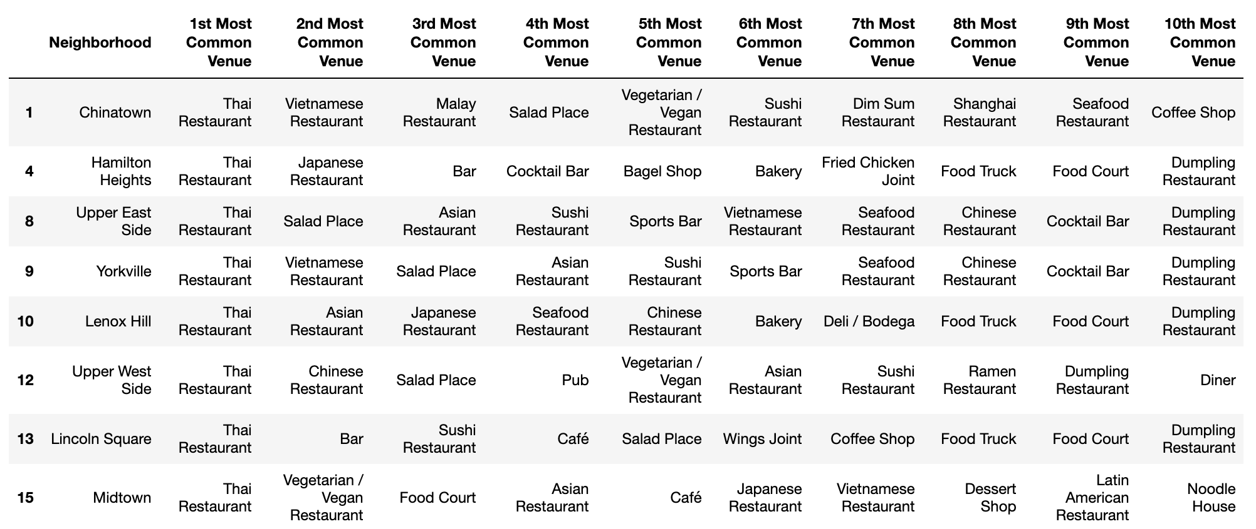
Results – Cluster 1

Slide 13
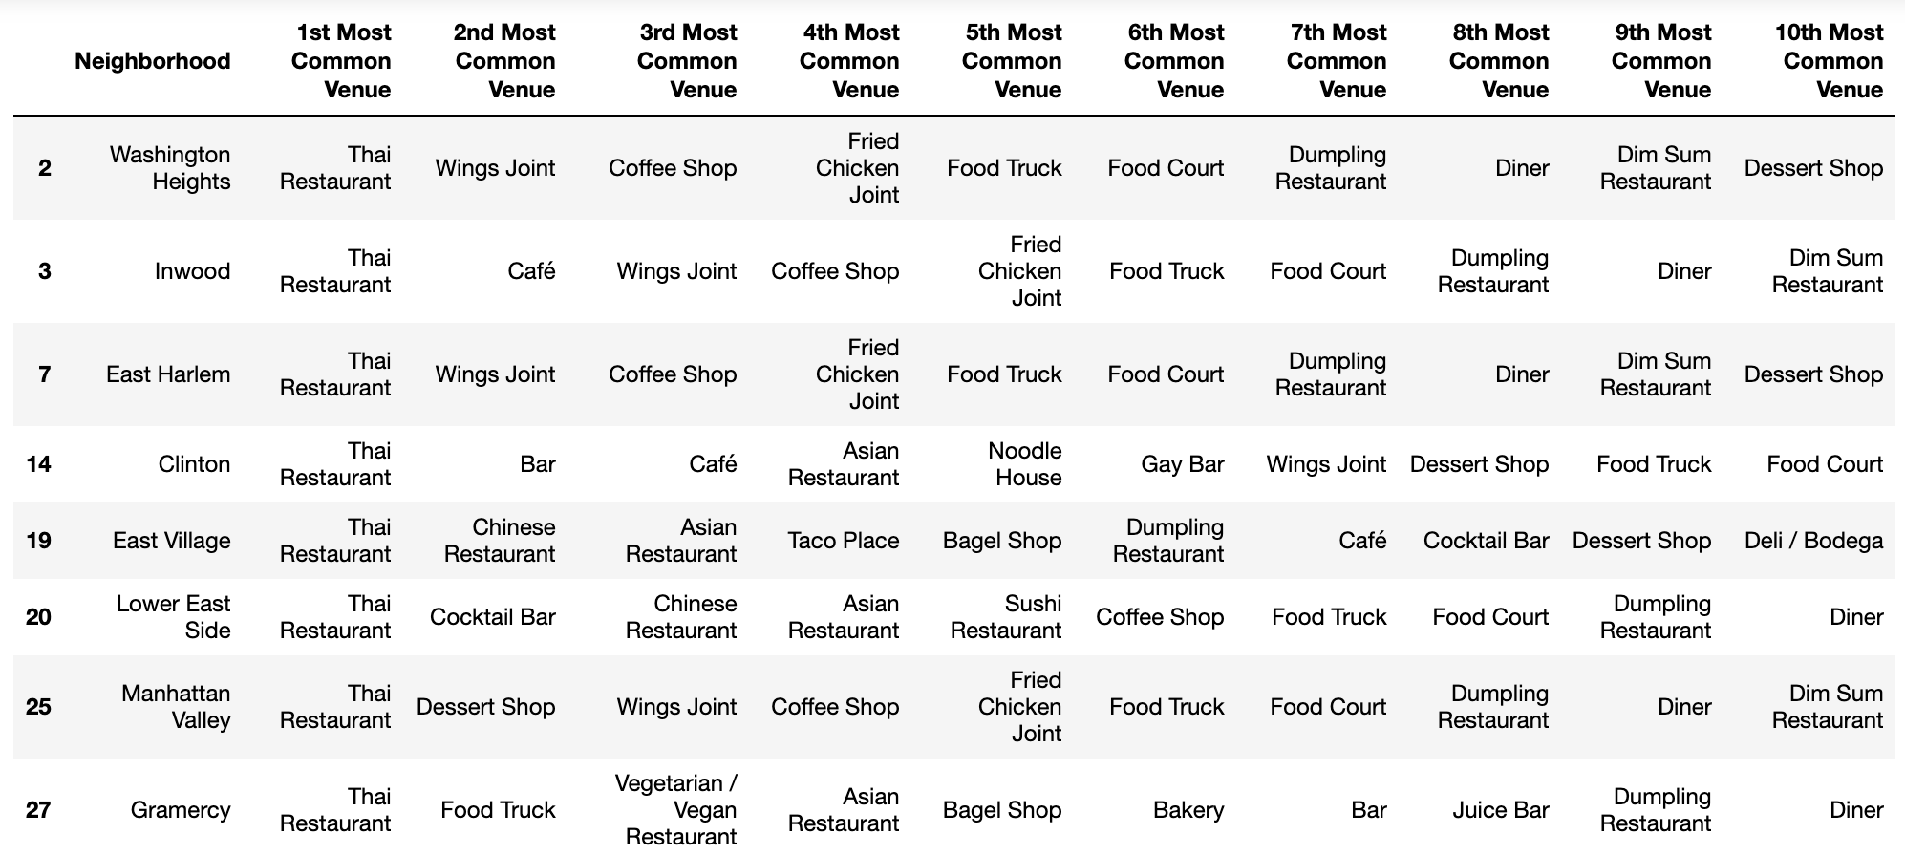
Results – Cluster 2

Slide 14
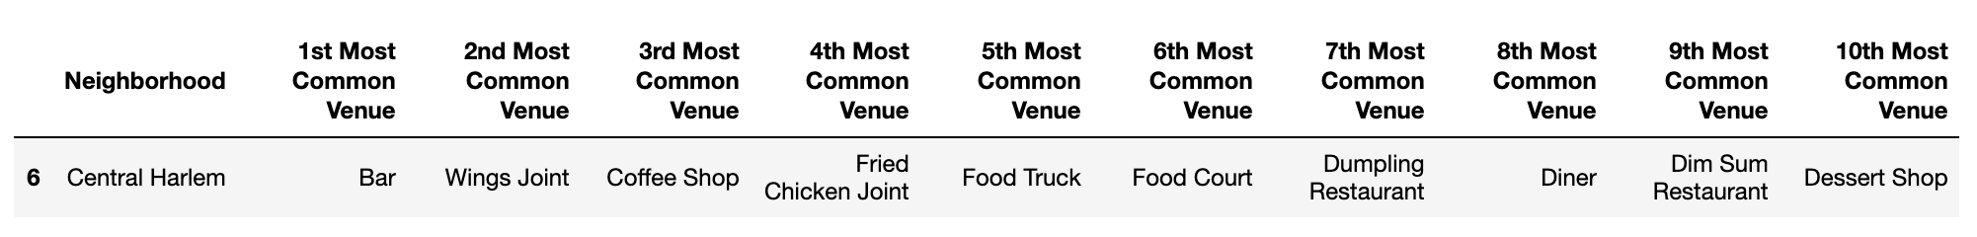
Results – Cluster 3

Slide 15
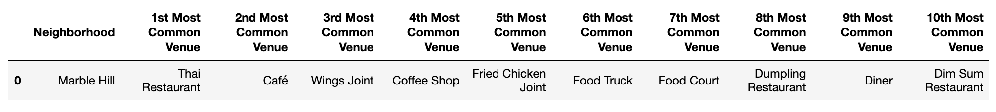
Results – Cluster 4

Slide 16
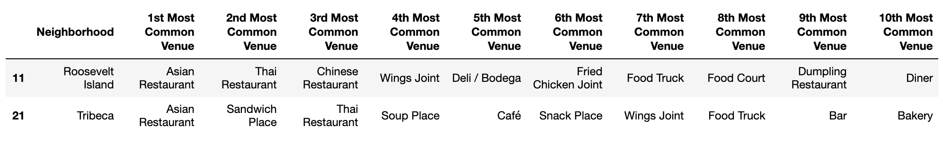
Results – Cluster 5

Slide 17
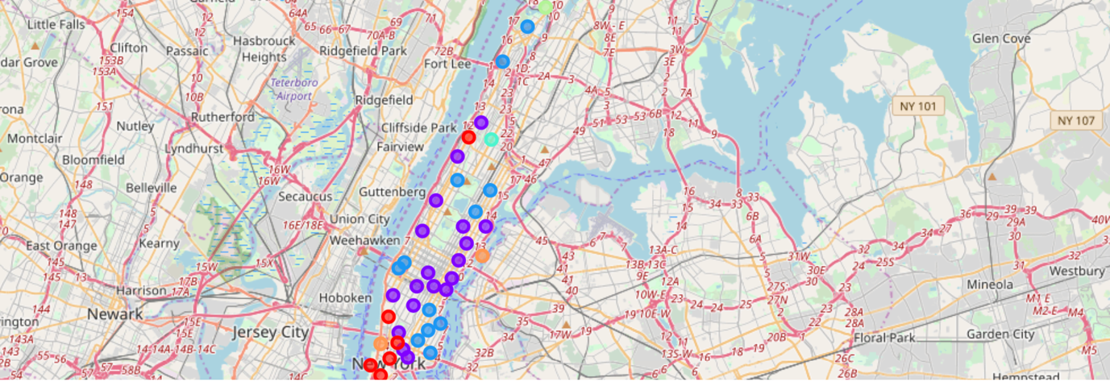
Results

Slide 18
Discussion
This analysis perform on limited data. This may be correct or maybe not but if massive of data is available there will be better result
There is scope to explore restaurant in Manhattan only

Slide 19
Conclusion
The best place to investing the Thai restaurant is Central Harlem. Inferior are Roosevelt Island and Tribeca have a nice Asian Restaurant environment. Thus, the people who want to eat Asian food usually go to those places

Slide 20
Thankyou

